Slide 1
Managing Development of Heterogeneous M&S Software: Medland Modeling Laboratory
June 11, 2016

Slide 2
Git
There are a variety of methods and tools for disciplined software development
Distributed Version Control System

Slide 3
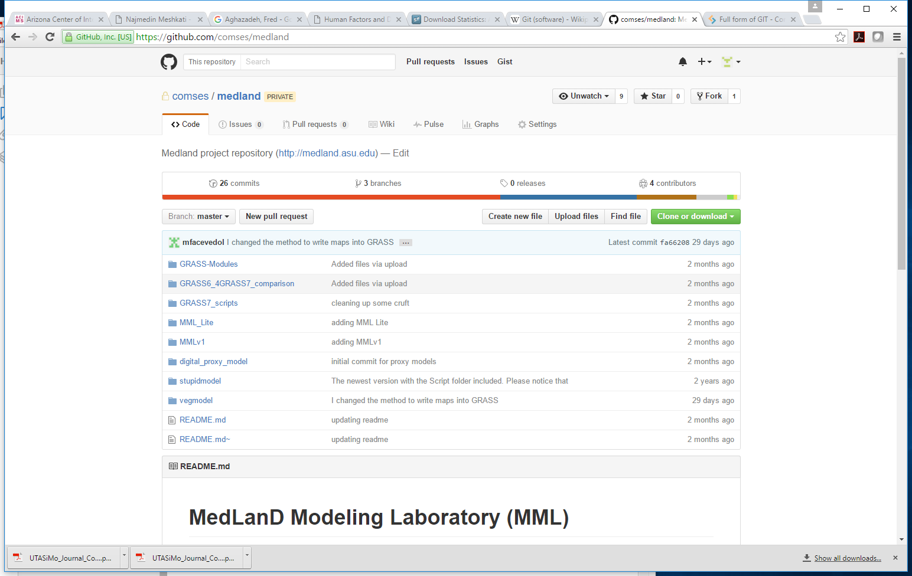
June 11, 2016

Slide 4
Medland Modeling Laboratory
Version | Human (Agents) | Land (GRASS) | Veg | Inter (KIB) | DEVS/ Repast | GRASS | Script | OS | Comment | Release Date
1.0 | 1.0 | 1.0 | – | 1.0 | DEVS | 6.4 | Bash ? |  | DEVSJAVA 2.1, JRE 4-7 | 2009
2.0 | 1.0 | 1.0 | – | 1.0 | Repast | 6.4 | Python 2.7 |  | DEVS -> Repast, , JRE 4-7 Bash -> Python | 2013
3.0 | 1.0 | 1.5 | – | 1.0 | Repast | 6.4 |  |  | Scripts optimized (~35% speedup) | 2014
4.0 | 1.0 | 2.0 | – | 1.0 | Repast | 6.4 |  |  | New GRASS scripts; added test suites for these GRASS scripts | 2015
5.0 | 1.0 | 3.0 | – | 1.0 | Repast | 7.0 |  |  | Landscape scripts ported from GRASS 6.4 to 7.0 | June 2016
5.5 |  | 3.0 | 0.1 | 2.0 | Repast | 7.0 |  |  | New Veg + new KIB
6.0 |  | 4.0 | 1.0 | 2.0 | Repast | 7.0 |  |  | New GRASS scripts; added test suites for these GRASS scripts

Slide 5
MML Versions 1.0 → 4.x
GRASS 6.4
DEVS and Repast
Bash and Python
MML 1.0
MML 2.0
MML 3.0
MML 4.0
MML 4.x
Land 1.5
Land 2.0

Slide 6
Vegetation Versions 0.1 → 1.x
Uses GRASS 7
MML 5.5 will have
a new vegetation model
a new KIB model
MML 5.0
Veg. 0.1
Veg. 1.0

Slide 7
MML Versions 5.0 → 7.x
MML 5.5 will have
a new vegetation model
a new KIB model
MML 4.0
MML 5.0
MML 5.5
MML 6.0
Land 3.0
Veg 0.1
Veg 1.0
Land3.1
Land 4.0
KIB 2.0
KIB 2.1

